Slide 1
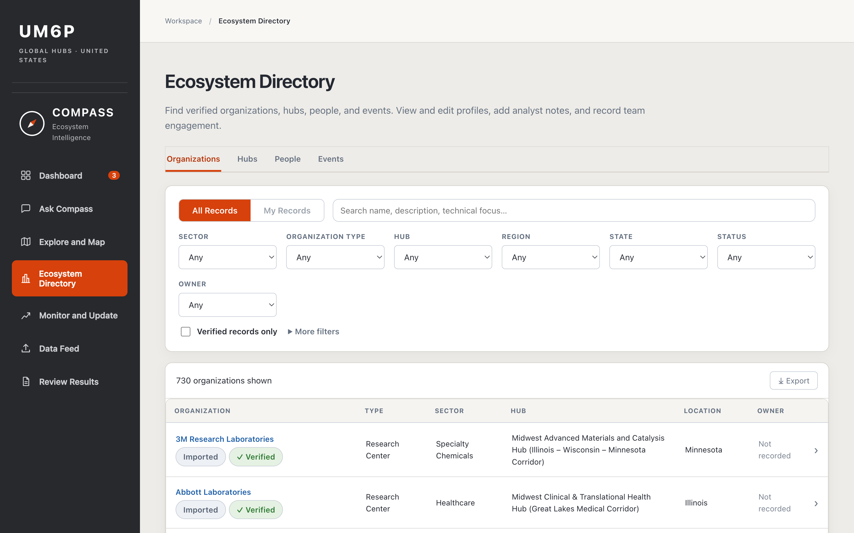
COMPASS at a glance: seven pages, one team
THE PLATFORM
PRESENTED NOW · NOUHAILA
Ask Compass
Questions answered from the directory, cited
Explore and Map
Web research that turns a question into a map
Ecosystem Directory
Every verified organization, hub, person and event
PRESENTED NEXT · ISMAIL
Dashboard
Running and finished searches, weekly figures
Monitor and Update
Scheduled searches on a topic, sector or area
Data Feed
Add records from Excel, CSV or by hand
The live platform: Ecosystem Directory, 10/30/2026
Review Results
A person admits each new find
COMPASS · Ecosystem Intelligence · 1
Notes:
Bird's-eye view before the detail. The menu on the left is what everyone sees when they open COMPASS. Seven pages in two halves: finding and keeping knowledge (Ask Compass, Explore and Map, Ecosystem Directory), which I present now; and keeping it current and deciding what enters it (Dashboard, Monitor and Update, Data Feed, Review Results), which Ismail presents after me. Whichever page a record comes from, a person decides before it enters the directory.

Slide 2

The agents behind COMPASS
HOW IT WORKS
SOURCES
AI AGENTS
A PERSON DECIDES
KEPT
Public websites
Ask Compass
Explore and Map
Verify
on a map, or approve in Review Results
Nothing enters on its own
Ecosystem Directory
Read by Ask Compass
The directory
Answers from the directory, with citations
Researches the web and builds a map
Your documents
Monitor
Update
Excel and CSV files
Scheduled searches on a topic
Re-reads an organization’s own pages
730
48
357
8
organizations
hubs
events
sectors
AI agents search and propose. People decide what enters the directory.
COMPASS · Ecosystem Intelligence · 2 · Directory counts as of 10/30/2026
Notes:
The agents in general. Two read and research: Ask Compass answers from the directory, Explore and Map researches the web and builds a map (both mine). Two keep things current: Monitor runs scheduled searches on a topic, Update re-reads an organization's own pages and proposes changes (both Ismail's). Whatever an agent finds, a person verifies or reviews it before it enters the directory, and Ask then reads from that same directory. Directory counts from a read-only check on 30 Oct 2026; recheck just before presenting.

Slide 3
What do we already know?
ASK COMPASS
WHAT IT DOES
Answers questions in plain language about what is already in the directory.
EXAMPLE
“Which organizations in our directory work on phosphate or phosphogypsum?”
WHAT IT’S FOR
Checking what we have before starting new research.
A short answer, with the organizations listed and a citation for each one.
SOURCE OF INFORMATION
The directory (verified and parked records), plus any document you attach.
Verified database
Parked
Your document
WHAT YOU GET
Not enough? “Research this on the web” opens Explore and Map.
A short answer with a citation for every record.
COMPASS · Ecosystem Intelligence · 3
Notes:
Ask Compass works only on what we already hold. Every source is labelled Verified database, Parked or Your document, so nobody mistakes an unverified record for a checked one. Demo: ask the phosphate question, then click Research this on the web to hand over to Explore and Map.

Slide 4
Who else should we know?
EXPLORE AND MAP
WHAT IT DOES
Asks what you need, searches the web, and shows results under your message.
EXAMPLE
“US partners for UM6P’s work on phosphate fertilizers and soil health.”
WHAT IT’S FOR
Finding new organizations, people and events for a goal, sector and area.
Compass asks: what type, and where?
SOURCE OF INFORMATION
“Research centers first, in Florida.”
Public websites found through web search. Compass reads each page, and every result links to the pages behind it.
Results appear under the message. Verify, Park or Reject each card, then save the verified ones to the directory.
WHAT YOU GET
A map you review card by card, then save the verified records in one batch.
COMPASS · Ecosystem Intelligence · 4
Notes:
The first message always gets questions back: what type, and where. That is what makes the map fit the need. One type per search; a follow-up can switch to people or events. Saving goes through the Data Feed: new organizations enter as AI mapped, and anything that matches an existing record goes to Review Results, so nothing is duplicated. Cost is shown on screen and capped at $2 per map.

Slide 5
What we keep
ECOSYSTEM DIRECTORY
WHAT IT DOES
Shows every organization, hub, person and event, with search and filters.
EXAMPLE
Energy Transition
Texas
Houston
WHAT IT’S FOR
One trusted place to look up, compare and export partners.
43 organizations shown
SOURCE OF INFORMATION
Open a profile: description, sources, status and history.
Export the list as CSV.
Remove a record: it can always be restored.
Records imported by GHUS, plus records AI mapped and verified by the team.
WHAT YOU GET
A profile per record with its sources, status and history.
COMPASS · Ecosystem Intelligence · 5
Notes:
Show the Energy Transition, Texas, Houston filter, open a profile and its sources, then Export. Be honest: edits are not saved yet, Delete works for organizations only, and there are no logins yet, so Owner reads Not recorded. Recheck the 43 just before presenting.

Slide 6
Why not just Google or ChatGPT?
WHY COMPASS
Google
ChatGPT / Claude
COMPASS
Knows what GHUS has
No
No
Yes: checks the directory, flags what we hold
Keeps the results
Links to collect by hand
In one person’s chat
In a directory the whole team shares
Who decides
You, alone
The model’s answer
A person verifies every record
Same structure
No
Changes each answer
Same fields, sectors and types
Missing information
Not visible
Not always marked
Shown as “Not found”, never guessed
Google finds pages. A chatbot gives answers. COMPASS builds and keeps a verified directory.
COMPASS · Ecosystem Intelligence · 6
Notes:
Be fair: chatbots can search the web and cite sources now too. The difference is that COMPASS knows what GHUS already holds and keeps a shared, checked record. Each row points back to something shown in the demo.

Slide 7
Minutes per map, cents per result, every result sourced
IN NUMBERS
MAPS
TIME
COST
SOURCED
22
6 min
$0.47
100%
416 results: organizations, people and events
median research per map
median per map, about $0.03 per result, never over $2
of results link to the pages behind them
NEXT
Logins: My Records and Owner
Saving Directory edits
People in the directory
COMPASS · Ecosystem Intelligence · 7 · 22 maps, 416 results, 9/13–10/30/2026
Notes:
Measured on all 22 completed maps, 13 Sept to 30 Oct 2026: 416 results (259 organizations, 96 people, 61 events). Research time counts only the searching, not the time a map waited for a reply; range 1 to 11 min. Cost includes follow-up and people searches; range $0.22 to $1.45, never over the $2 cap. Every result has at least one source link (633 links in total). Recompute before presenting.

